Slide 1
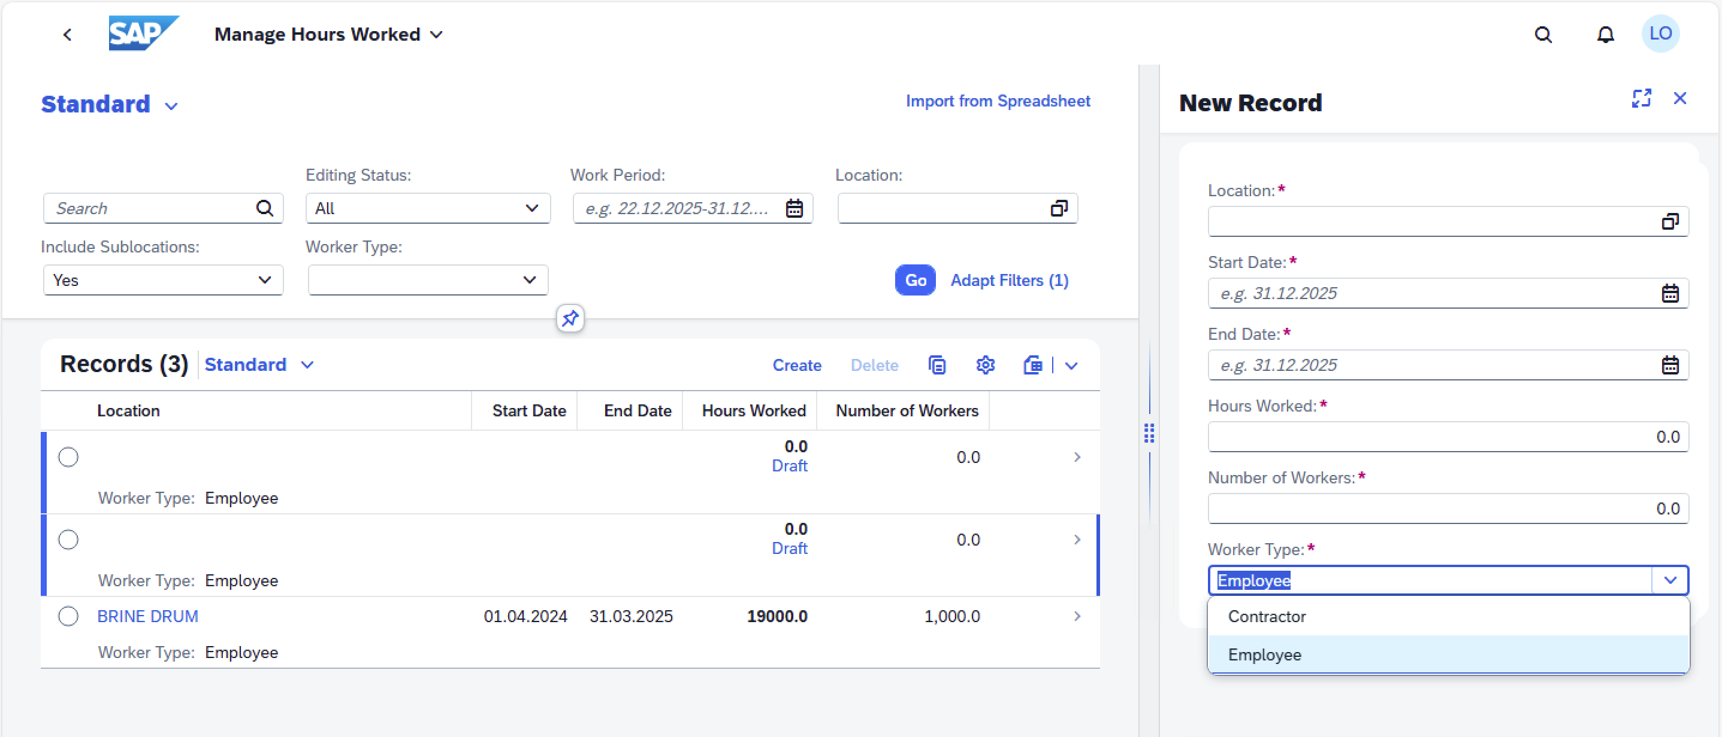
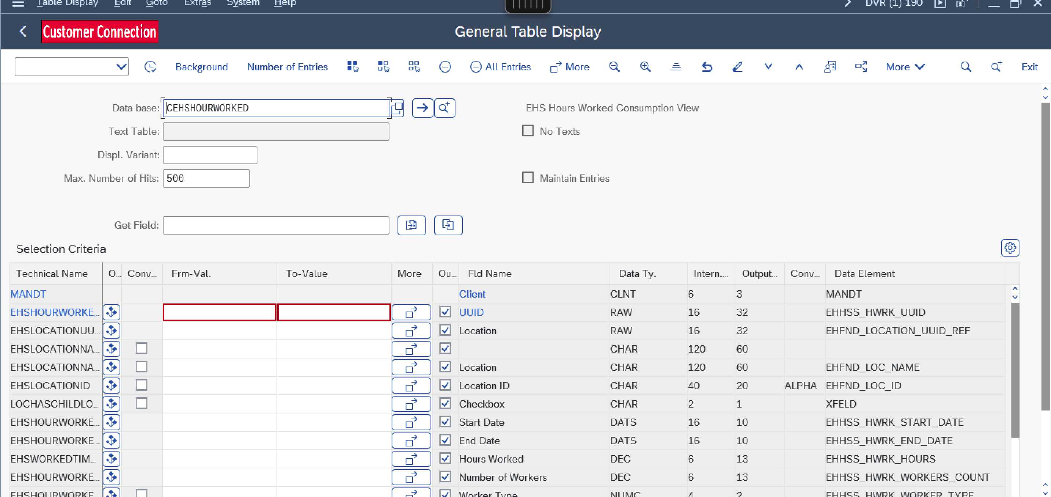
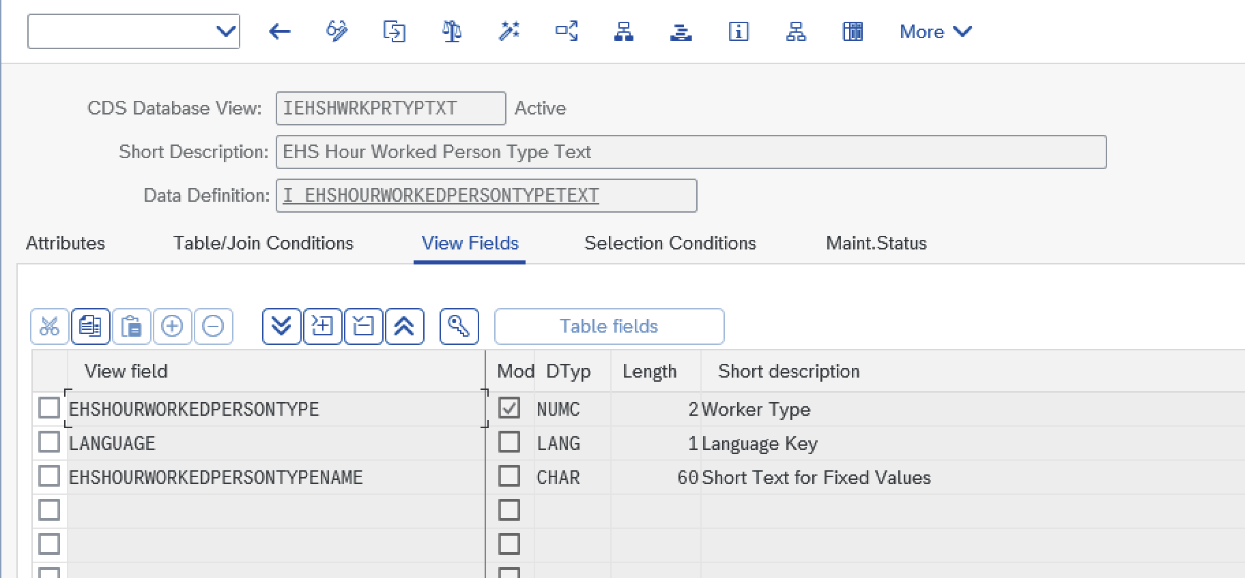
Table : CEHSHOURWORKED App name : Manage work hours
Worker type changes - Add Contractor Male and Contractor Female
We have add plant as mandatory instead of location

Slide 2
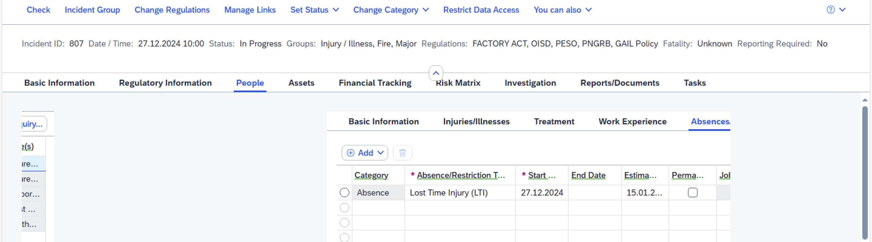
Number of lost time Injuries – Custom development
DART - Employees away from work/Frequency Rate
Proposed Formula
The DART/Frequency Rate shall be calculated for lost time injury as follows:
DART/Frequency Rate: Number of Lost Time Injuries x1000000/Man-Hours Worked
Logic for DART :
Number of lost Time injures : This values considered from People table → Injured person → Absences /restriction tab
Category : Absence
Absences /restriction type: Lost time injury (LTI) (We have considered one if entry is available)
Example : if in year 2024 to 2025 - lost time injured occurred are 6
Man-Hours Worked : 2,500,000 total hours in a year
Calculation will be : (6 *1000000)/ 2,500,000
Result : 2.4 lost time injuries for every 1 million hours worked
Man-hours worked : table : CEHSHOURWORKED – field EHSWORKEDTIMEINHOURS
Number of lost Time injures
Table: EHHSSD_INC_RESDU
Filed: RESDU-WORK_DAY_MEAS
Category : Absence
Key Filter : EHHSSD_INC_ROOT
Category : 001

Slide 3
Condition 1) Incident Category 001
Condition 2) Person Role: Injured person
Condition 3) Category : Absence
Condition 4) Absences /restriction type: Lost time injury (LTI)
Condition 1) Incident Category 001. EHHSSD_INC_ROOT - CATEGORY
Condition 2) Person Role: Injured person : EHHSSD_INC_PROLE role: EHHSS_PR_INJURED_PER
Condition 3) Category : Absence EHHSSD_INC_RESDU – CATEGORY

Slide 4
Condition 1) Incident Category 001
Condition 2) Person Role: Injured person
Condition 3) Category : Absence
Condition 4) Absences /restriction type: Lost time injury (LTI)
From table EHHSSD_INC_ROOT get EHHSSD_INC_ROOT-ID and get the respective EHHSSD_INC_ROOT-DB_KEY. Pass this value in EHHSSD_INC_PROLE-ROOT_KEY and consider only those EHHSSD_INC_PROLE-ROLE = “EHHSS_PR_INJURED_PER”. Now pass EHHSSD_INC_PROLE-DB_KEY to EHHSSD_INC_RESDU-PARENT_KEY and get EHHSSD_INC_RESDU-WORK_DAY_MEAS and Multiply by 24 and show it against the Person Injured, Derived from the following logic. Pass EHHSSD_INC_RESDU-PARENT_KEY in EHHSSD_INC_PROLE-DB_KEY. Pass EHHSSD_INC_PROLE-PARENT_KEY in EHHSSD_INC_PINV-DB_KEY and show it against this injured person. If more than 1 person get involved in an incident, then display all the values from EHHSSD_INC_PINV-DB_KEY.

Slide 5
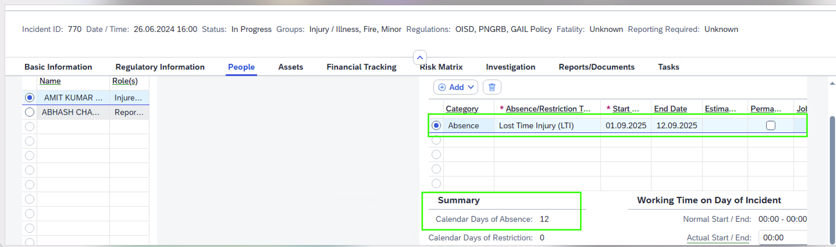
Logic for Severity Rate
Incident Rate proposed to be replaced with Severity Rate
Proposed Formula
The Severity Rate shall be calculated from man-days loss of lost time injury as follows:
Severity Rate: Man-days lost due to Lost Time Injury x1000000/Man-Hours Worked
Number of lost Time injures : This values considered from People table → Injured person → Absences /restriction tab
Category : Absence
Absences /restriction type: Lost time injury (LTI)
Man-days lost due to Lost Time Injury - Calendar days of Absence. ( We have considered number of days)
Example: Man-days lost due to Lost Time Injury (including the weekend) – 38
Employee A: 5 man-days
Employee B: 3 man-days
Employee C: 30 man-days
Total man-days lost = 5 + 3 + 30 = 38 man-days.
Man-Hours Worked : 2,500,000 total hours in a year
Calculation: (38*1000000)/ 2,500,000
Result: Lost Time Injury Severity Rate 15.2

